Slide 1
WELCOME

Slide 2
Project Name:-
Car Showroom Website
Presented by:-
Aher Dhiraj Dilip

Slide 3
Index-
Introduction
Scope of project
Objective and Goals
Main Operation
Input Output Operation
Advantages and Disadvantages of project
Feature Enhancement
Conclusion
System Requirement
Bibliography and Webliography

Slide 4
Introduction -
Car Showroom is a project that is used to manage and control the complete record of Cars. This mini project is to present hold the record of Cars, Customers, corporations, booking.
This Car showroom Project is devised for owners and users who are engaged in cars. This system has the track of all the cars with every single detail. From the date of production to up to what price can one consult while taking that car, one can view all the data here. If someone is involved in buying the car, then he/she can reach the retailer as well for the same, via the system.

Slide 5
Scope of Project
Car showroom Project provides solution for showrooms for organizing data using software application. This software application helps administrator to update data in step by step process while selling car to customer.
Using this Website can update customers information, car information, payment details, Insurance details, take orders. etc.

Slide 6
Objective and Goals –
The main objective and goals behind the development to this project are as follows:
Car showroom Management carries all the information related to vehicles number, controlling the position
One-stop data of car includes engine number, registration number RC book number, and more It also can store data of legal documents like insurance road tax, user can also upload scan copy of the documents
Daily / Weekly / Monthly alarms can be set for the future renewal of documents Location-wise user wise alert list can be configured

Slide 7
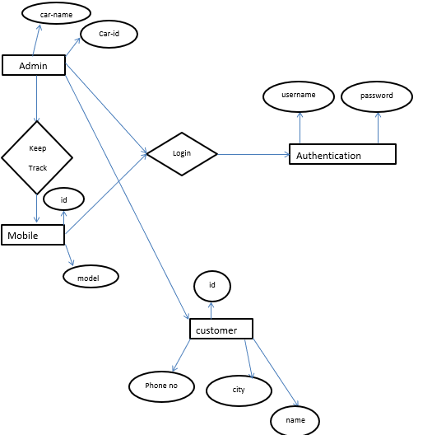
Entity Relationship Diagram

Slide 8
Main Operation -
Home
Login
Menu
About us
Products
Contact

Slide 9
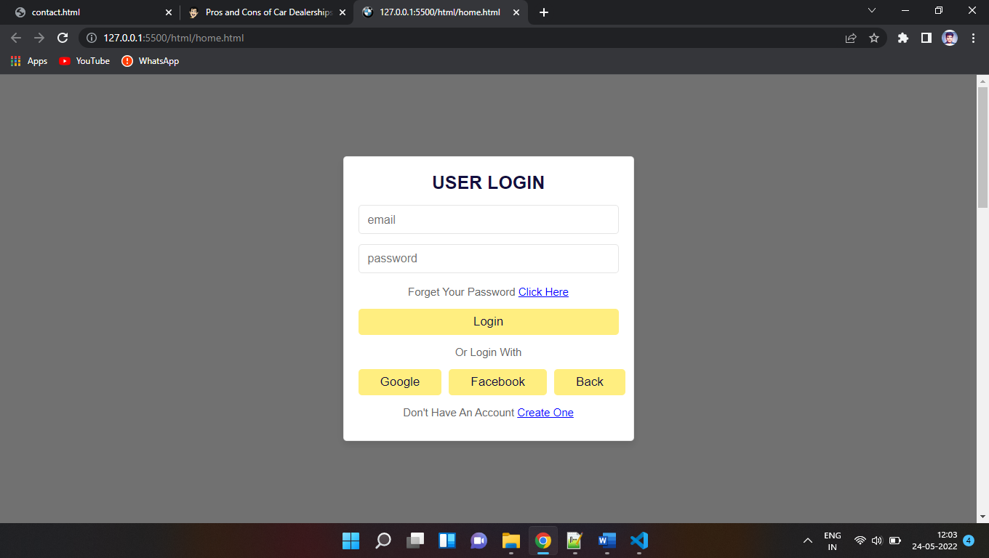
Input Output Operation –
Login Page

Slide 10
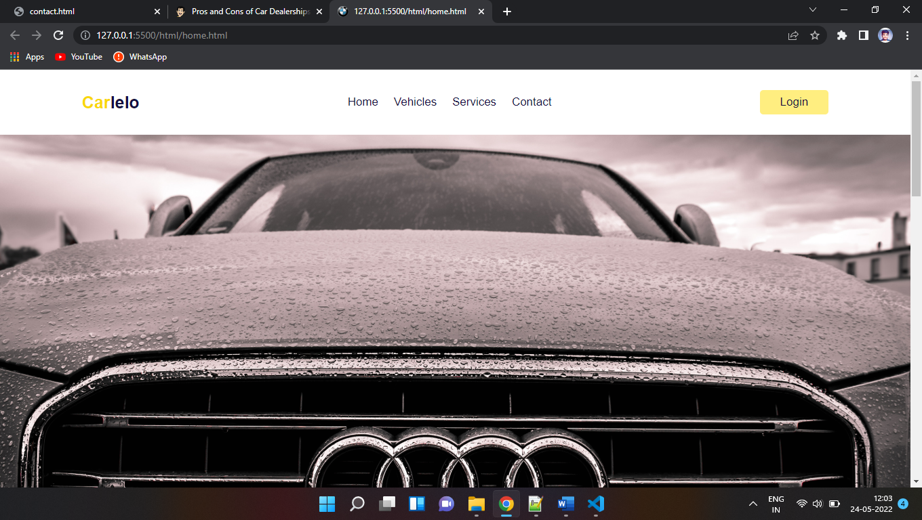
Input Output Operation –
Home Page

Slide 11
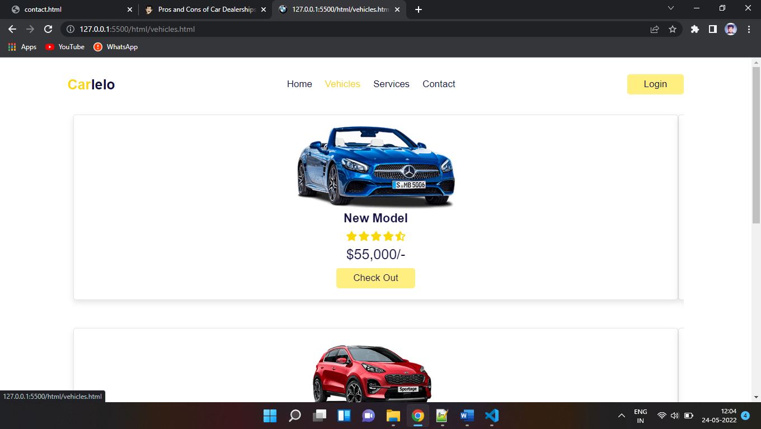
Input Output Operation –
Vehicles Page

Slide 12
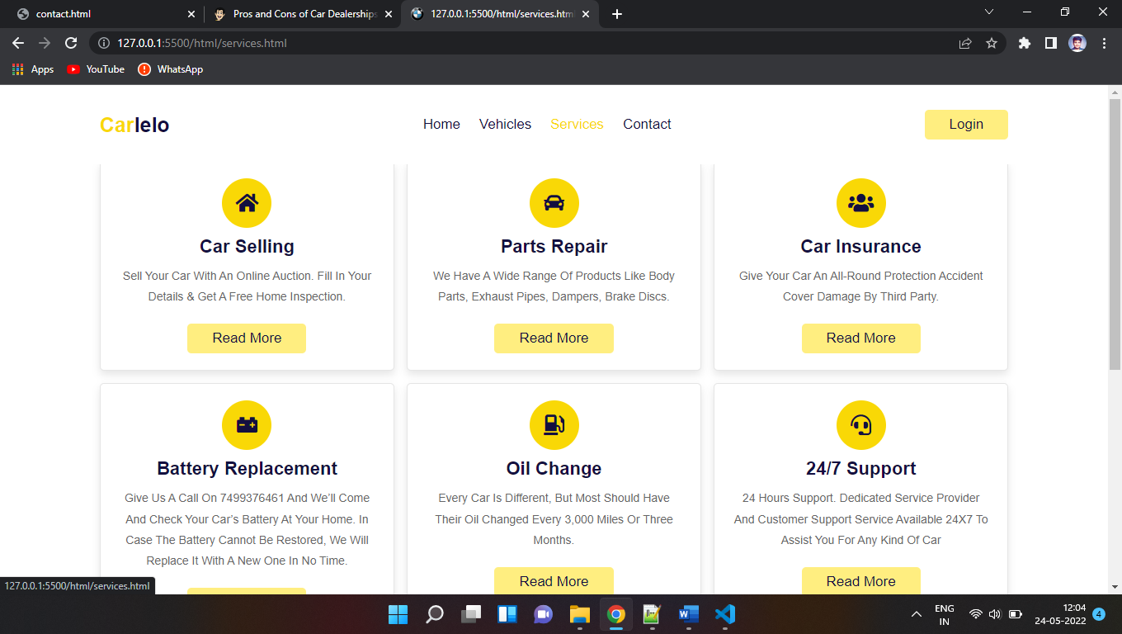
Input Output Operation –
Services Page

Slide 13
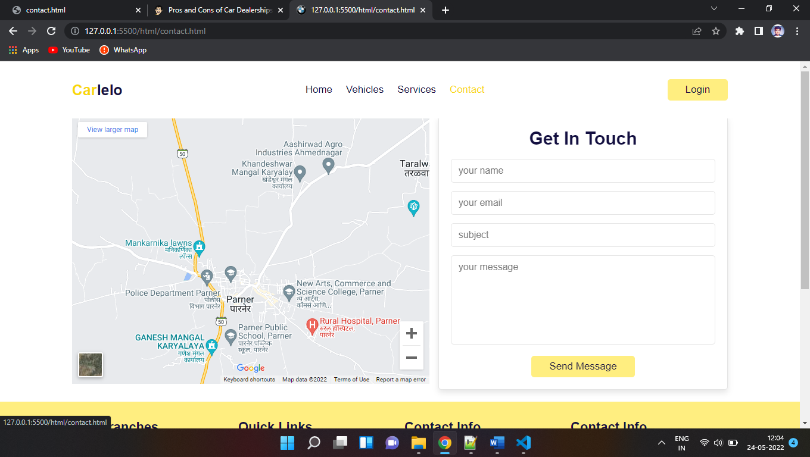
Input Output Operation –
Contact Page

Slide 14
Advantages and Disadvantages of project -
Advantages:-
Many consumers are surprised to learn that dealerships are also in the collision repair business (servicing all makes and models). Dealerships either have a collision repair shop on site or they are affiliated with a reputable shop nearby.
If you are involved in a collision, it’s your legal right to choose where you want your vehicle repaired.
Disadvantages:-
With franchising, you are constrained to the pre-established model of business.
With private dealerships, you are constrained by your financial backing.

Slide 15
Feature Enhancement -
Car showroom carries all the information related to vehicles number, controlling the position One-stop data of car includes engine number, registration number RC book number, and more
It also can store data of legal documents like insurance road tax, user can also upload scan copy of the documents
Daily / Weekly / Monthly alarms can be set for the future renewal of documents Location-wise user wise alert list can be configured

Slide 16
Conclusion -
This is the perfect system for the car showrooms to manage their data and help their customers to buy a car without any problem. It makes the process of buying a car very simpler.

Slide 17
System Requirement -
Hardware Requirement:-
Processor: Pentium p4 and Above
Main Memory: Minimum 1 GB RAM
Hard Disk:4 GB and Above
Software Requirement:-
Operating System: Windows XP, Windows 10 etc.
Front-End: HTML, CSS, JavaScript and Bootstrap.

Slide 18
Bibliography and Webliography -
BIBLIOGRAPHY:-
Web Developing Absolute Beginner’s Guide (3rd Edition) - Dean Miller
Mastering HTML, CSS, JavaScript web publishing (1st Edition) - Nirali Prakashan
WEBLIOGRAPHY:-
-http://www.google.com
-http://www.w3school.com
-http://www.tutorialspoint.com

Slide 19
THANK YOU

